Slide 1
Real time monitoring of crack growth in rail, using acoustic emission techniques
Richard Culwick, Valter Jantara Junior and Mayorkinos Papaelias

Slide 2
Summary
The challenges facing rail network
Principles of AE monitoring
Simulation of rail fatigue and data collection
Comparison of AE Energy and crack growth
AE detection of crack growth events

Slide 3
The challenges facing rail networks
Increasing passenger numbers and loads
24 hour networks
Increased wear and costs
Engineering works
Current monitoring challanges
Cancellations and delays
"Rail chaos" by Andrew Burrows is licensed under CC BY-NC-SA 2.0
"Is there a wildcat strike on? So many Southern trains cancelled due to train crew shortage the last few weeks" by katybird is licensed under CC BY-NC-SA 2.0
"London Waterloo Station - ticket barriers and South West Trains - 450 114 and 450 102" by ell brown is licensed under CC BY-NC-SA 2.0
"Engineering work at Cardiff Central railway station" by Dai Lygad is licensed under CC BY 2.0

Slide 4
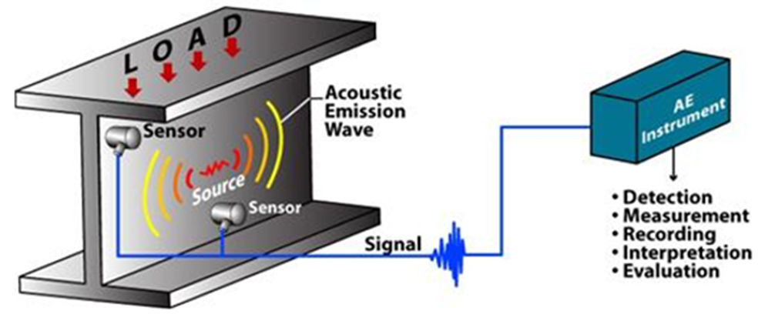
Principles of AE monitoring
SHI, S. Online Structural integrity Monitoring of Railway Infrastructure.

Slide 5
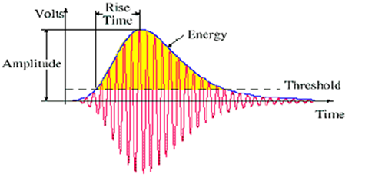
Principles of AE monitoring
Adapted from: Uddin A.K.M, F. (2002) Application of AE to Fracture Toughness and Crack Analysis by BEM in Concrete. NDT, 7 (9).

Slide 6
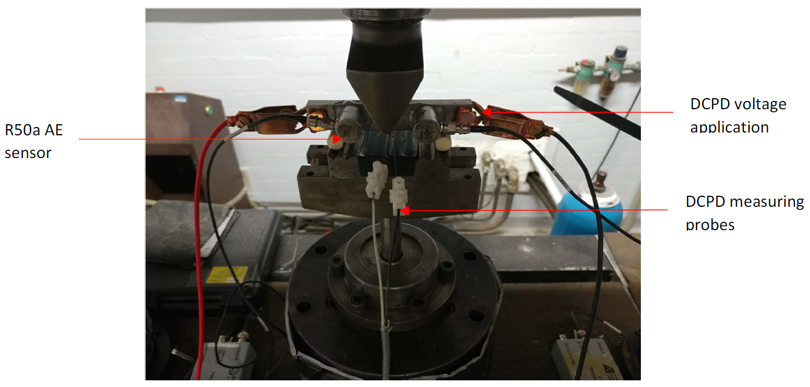
Simulation of rail fatigue and data collection

Slide 7
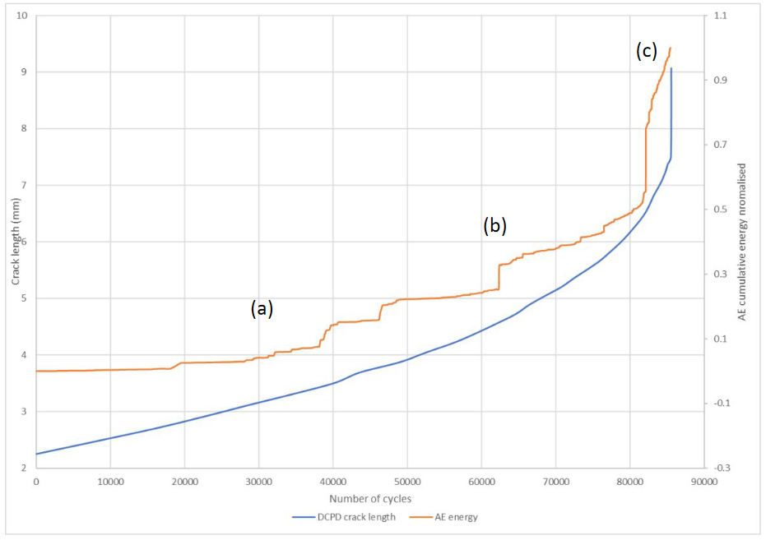
Comparison of AE Energy and crack growth

Slide 8
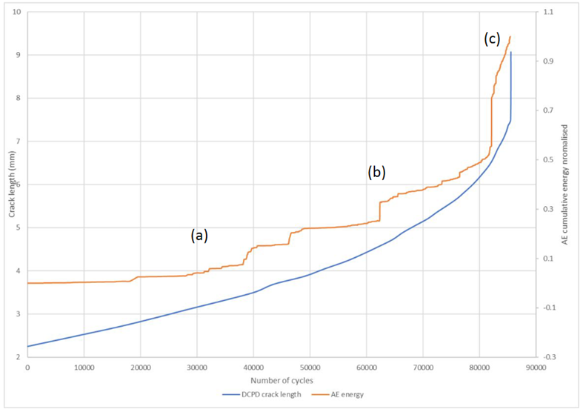
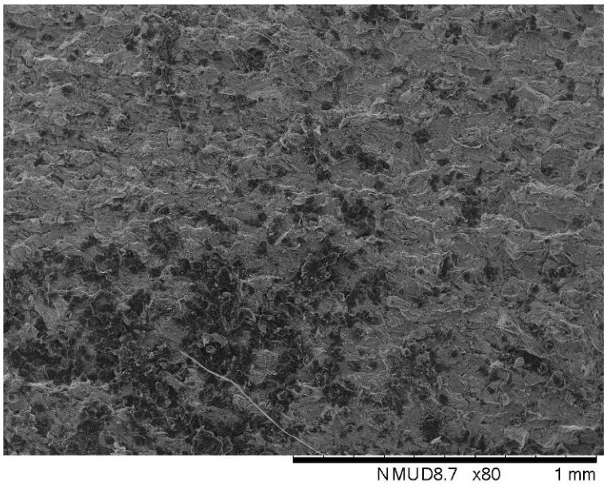
AE detection of crack growth events

Slide 9
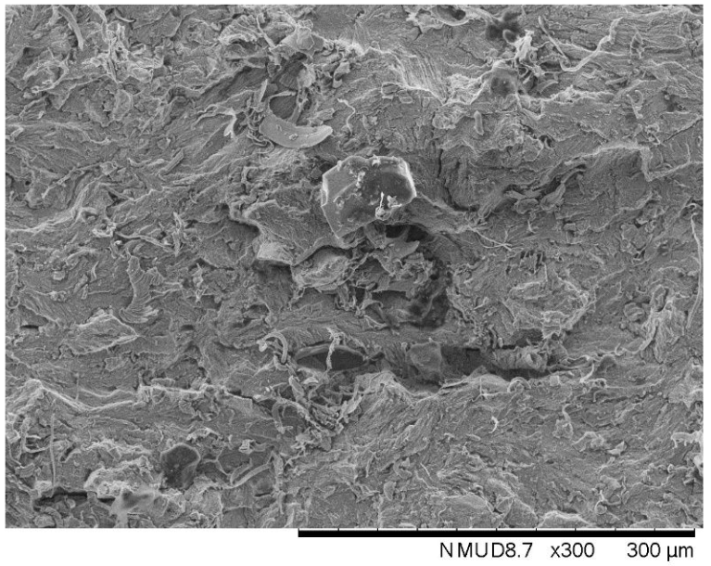
AE detection of crack growth events

Slide 10
AE detection of crack growth events
(a)
(b)

Slide 11
Summary
The challenges facing rail network maintenance
Principles of AE monitoring
Simulation of rail fatigue and data collection
Comparison of AE Energy to crack growth
AE detection of crack growth events

